Slide 1

Discussion 3: Linked Lists, Arrays

Slide 2
Administrivia
Project 1A due 2/8 at 11:59!
You will be implementing a deque interface
Most common piece of advice from TA’s and past students: START THE PROJECTS EARLY!! So pls start :)
Highly recommend to use Java Visualizer
Pre-semester advising available @414
Choose your mentor GSI here
Automated extension system available here
HKN provides past exams, hosts review sessions, and has drop-in tutoring services M-F, 11AM-5PM throughout the semester. See @574 for more information.
Weekly surveys will be announced on Piazza from now on so please check for those!

Slide 3

Review: SLList
5
10
15
The SLList is a class that hides the internal workings of the Linked List using something called encapsulation.
The raw linked list is a “naked structure”: you can see everything inside of it including first and rest. If someone were to use it, they would need to know what these are and also know how to step through the list.
The SLList allows us to hide away the inner workings of the linked list and also allows us to store meta-information about the list as a whole such as the size.
Analogy: You refer to a train as a whole, not as individual cars. In the same way, instead of just having the raw links with first and next, you refer to it as a whole.

Slide 4
Review: SLList Diagram
We add a size variable so we don’t have to step through the entire linked list every time we want the size
x
“First” is a pointer to the first link in the linked list.
addFirst()
size
first
getFirst()
3
We add these methods to abstract away the mechanics of adding items to, and getting items from, our list
addLast()
size()
5
10
15
item
next

Slide 5
Review: Sentinel Nodes
Let’s add some more useful stuff to our list class.
Question: How do we represent an empty linked list? Set first to null?
This leads to ugly code, as we will have to add a bunch of null checks to code that handles the list.
For example, addLast would need a special case for if the list is null → finding the old last is different if the list is null vs. if it has at least one item.
Goal of sentinel: make code as simple and generic as possible so we don’t have to have any special cases.
A sentinel is a “dummy” node that doesn’t actually hold any important information. It’s a placeholder that exists solely so we can avoid those pesky null checks.

Slide 6
Review: Sentinel Node Diagram
addFirst()
size
first
getFirst()
Instead of pointing to null, first points to the sentinel node.
0
addLast()
size()
??
item
next
The sentinel is not included in the size
addFirst()
size
first
getFirst()
3
addLast()
size()
??
5
10
15
item
next

Slide 7
Review: DLLists
One thing that a list should support is remove(int i) which removes the node whose item is i.
With our brand new SLList with sentinel, what would we have to do to remove a link?
Notes:
Having the extra arrows does increase the amount of memory you use.

Slide 8
Review: DLLists
One thing that a list should support is remove(int i) which removes the node whose item is i.
With our brand new SLList with sentinel, what would we have to do to remove a link?
. . .
5
10
15
Say we want to remove this node
Notes:
Having the extra arrows does increase the amount of memory you use.

Slide 9
Review: DLLists
One thing that a list should support is remove(int i) which removes the node whose item is i.
With our brand new SLList with sentinel, what would we have to do to remove a link?
. . .
5
10
15
1. We need to jump to that link
Notes:
Having the extra arrows does increase the amount of memory you use.

Slide 10
Review: DLLists
One thing that a list should support is remove(int i) which removes the node whose item is i.
With our brand new SLList with sentinel, what would we have to do to remove a link?
. . .
5
10
15
2.Save a reference to this node (If we don’t, we will lose it forever! We need it later)
Notes:
Having the extra arrows does increase the amount of memory you use.

Slide 11
Review: DLLists
One thing that a list should support is remove(int i) which removes the node whose item is i.
With our brand new SLList with sentinel, what would we have to do to remove a link?
. . .
5
10
15
3.Remove its “next” pointer
Notes:
Having the extra arrows does increase the amount of memory you use.

Slide 12
Review: DLLists
One thing that a list should support is remove(int i) which removes the node whose item is i.
With our brand new SLList with sentinel, what would we have to do to remove a link?
. . .
5
10
15
4.Jump to the node before
Notes:
Having the extra arrows does increase the amount of memory you use.

Slide 13
Review: DLLists
One thing that a list should support is remove(int i) which removes the node whose item is i.
With our brand new SLList with sentinel, what would we have to do to remove a link?
. . .
5
10
15
5.Reassign next to the node after
Notes:
Having the extra arrows does increase the amount of memory you use.

Slide 14
Review: DLLists
We had to traverse the list TWICE in order to do the job. That’s pretty inefficient.
To remedy this, we simply add some more pointers!
Instead of just having pointers that point to the “next” link, we add pointers that point to the “previous” link as well.
This allows you to traverse the list both forwards and backwards!
5
10
15
Notes:
Having the extra arrows does increase the amount of memory you use.

Slide 15
Review: ALists
Even with the super sophisticated Doubly linked list, it’ll still take a long time to traverse through the list.
This makes us wish we could go back to arrays.. which have that sweeeet constant access time.
But the bad thing about arrays is that you can’t add or remove items.
Let’s write a list class that takes advantage of both an array’s constant access time and a linked lists adding and removing feature.
AList is a list whose underlying structure is an array. To support add and remove, we choose to resize the array when the array is too full which consists of:
Making a new array that has twice as much space (this is called geometric resizing)
Copying all the items from the old array into the new array

Slide 16
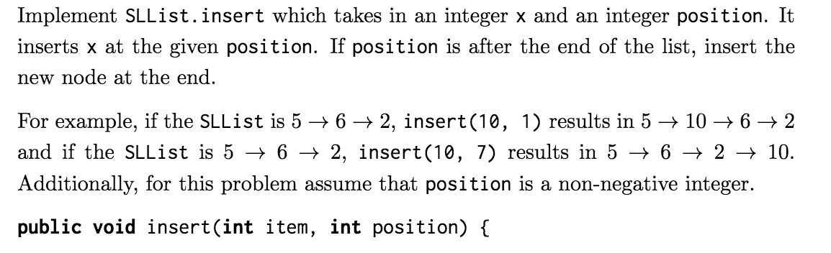
Exercise 1: insert
First, think about what types of things we need to check for (special cases).
How do we get to the specified position?
After we get there, how can we re-assign pointers such that we add the new node?

Slide 17
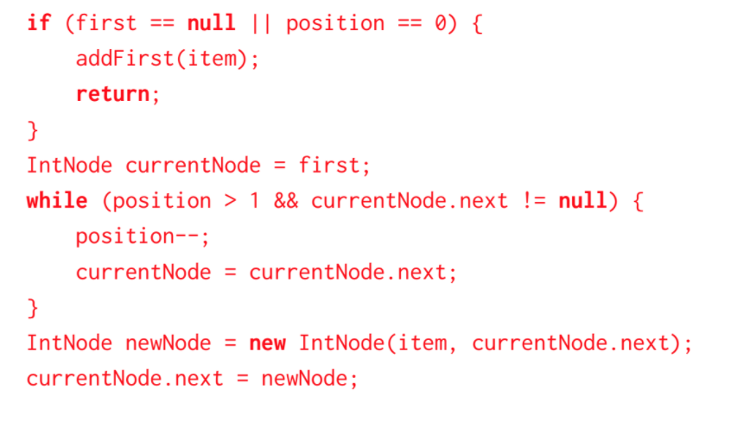
Exercise 1: insert

Slide 18
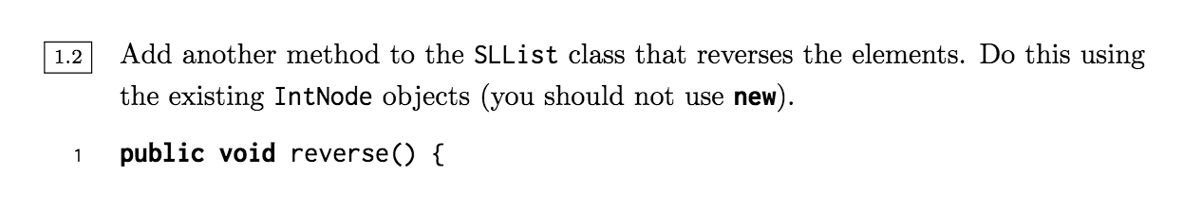
Exercise 2: reverse

Slide 19
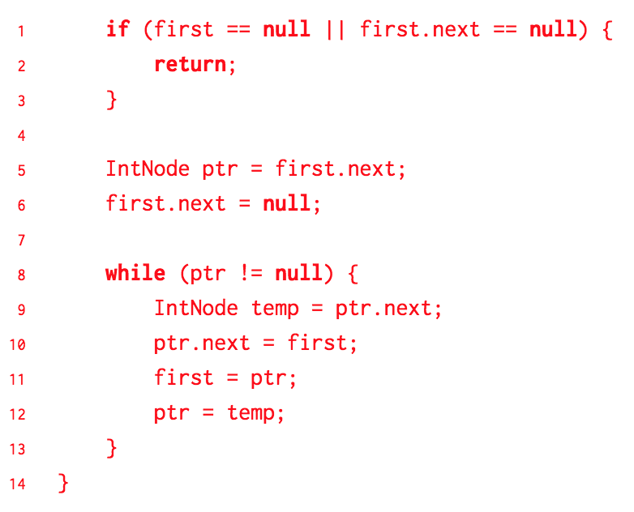
Exercise 2: reverse

Slide 20
Exercise 2.5: reverse Extra

Slide 21
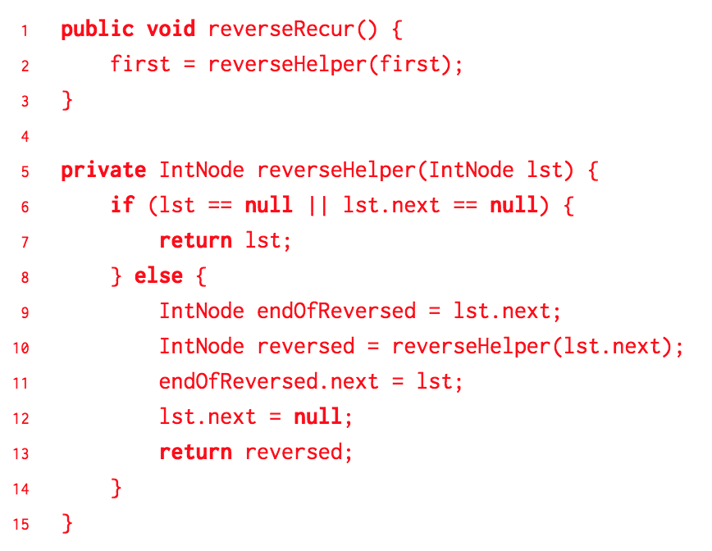
Exercise 2.5: reverse Extra

Slide 22
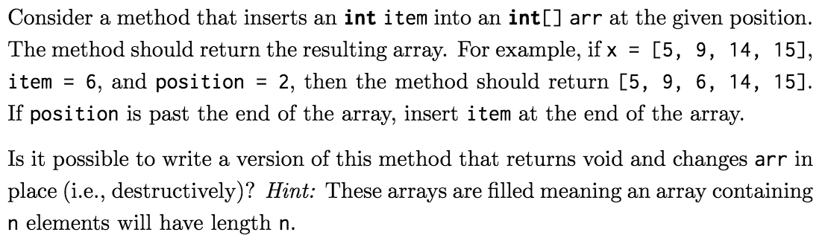
Exercise 3: Array insert

Slide 23
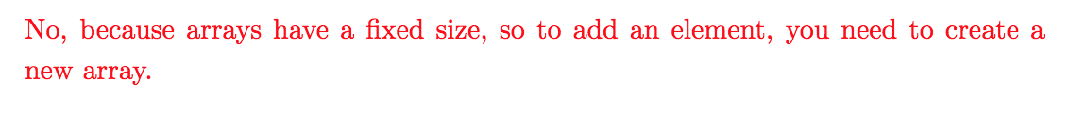
Exercise 3: Array insert

Slide 24
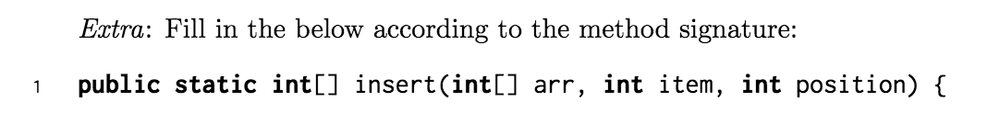
Exercise 3: Array insert Extra

Slide 25
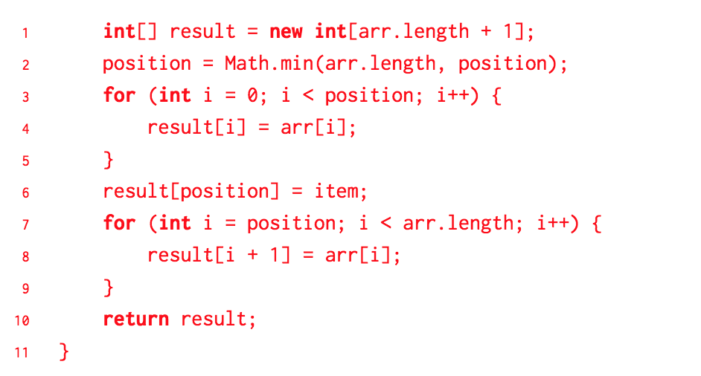
Exercise 3: Array insert Extra

Slide 26
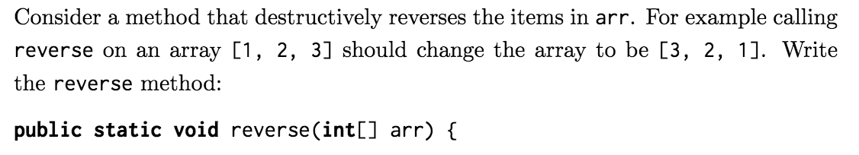
Exercise 4: Array reverse

Slide 27
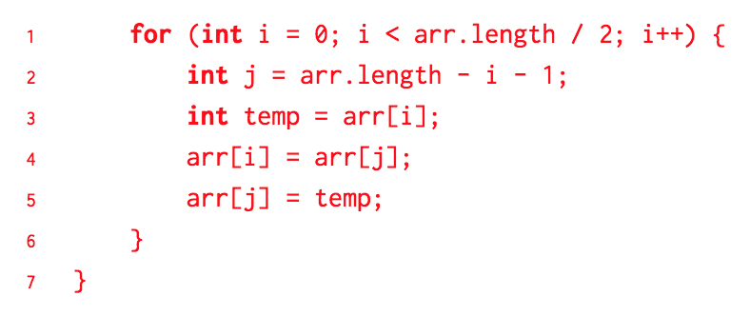
Exercise 4: Array reverse

Slide 28
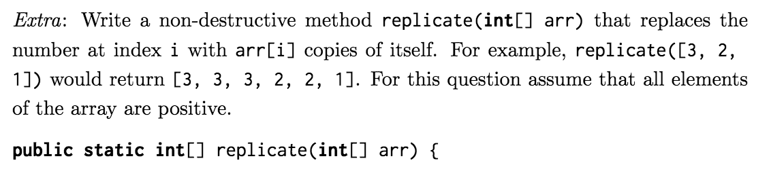
Exercise 5: Replicate Extra

Slide 29
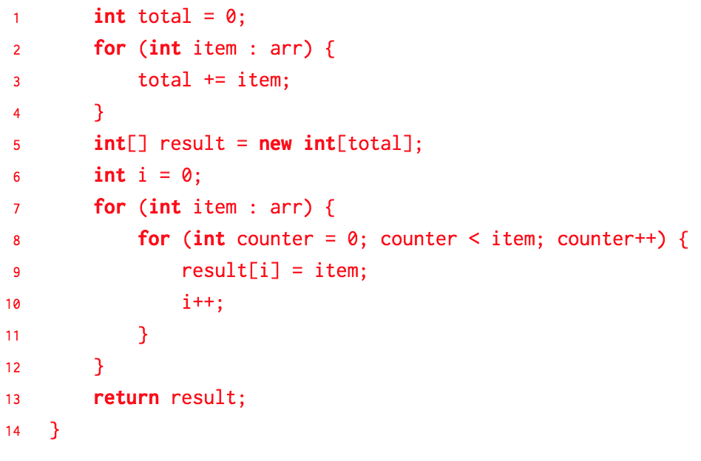
Exercise 5: Replicate Extra

